Slide 1
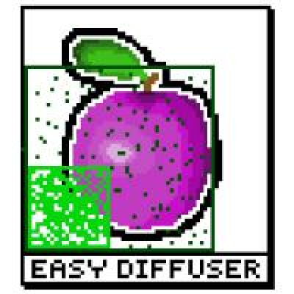
Easy Diffuser

Slide 2
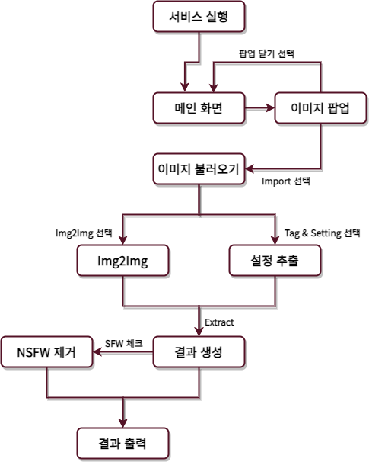

Slide 3
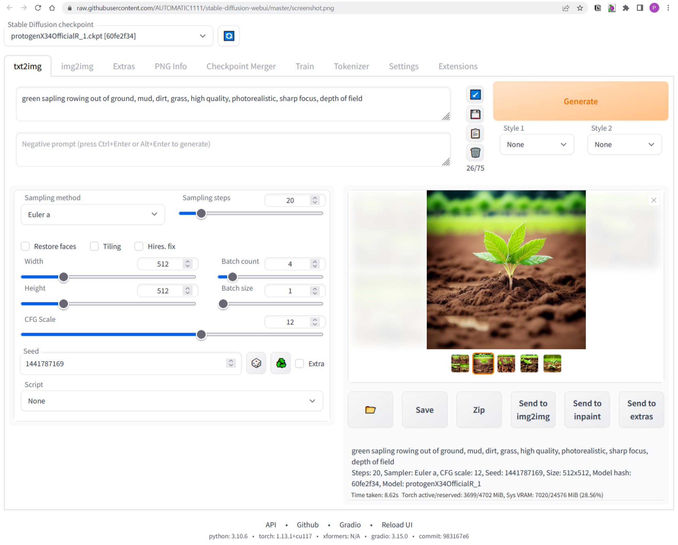
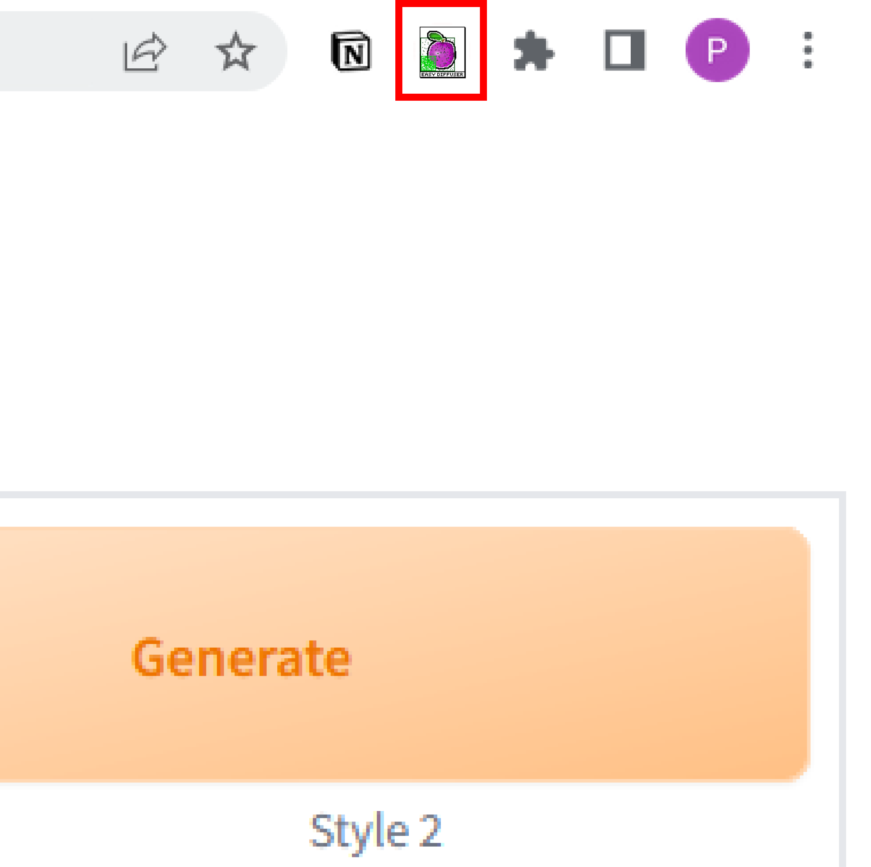
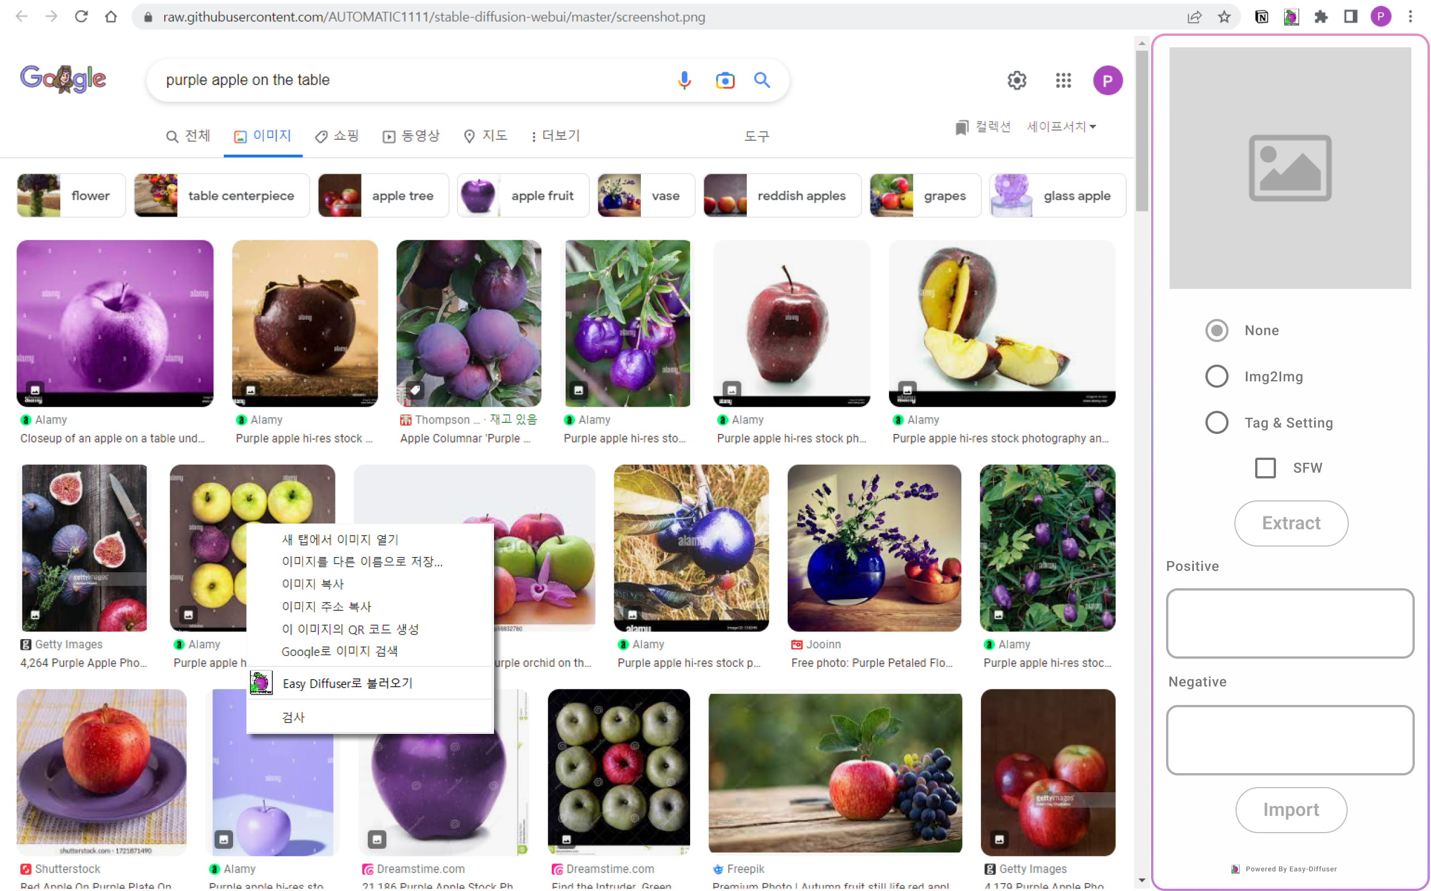
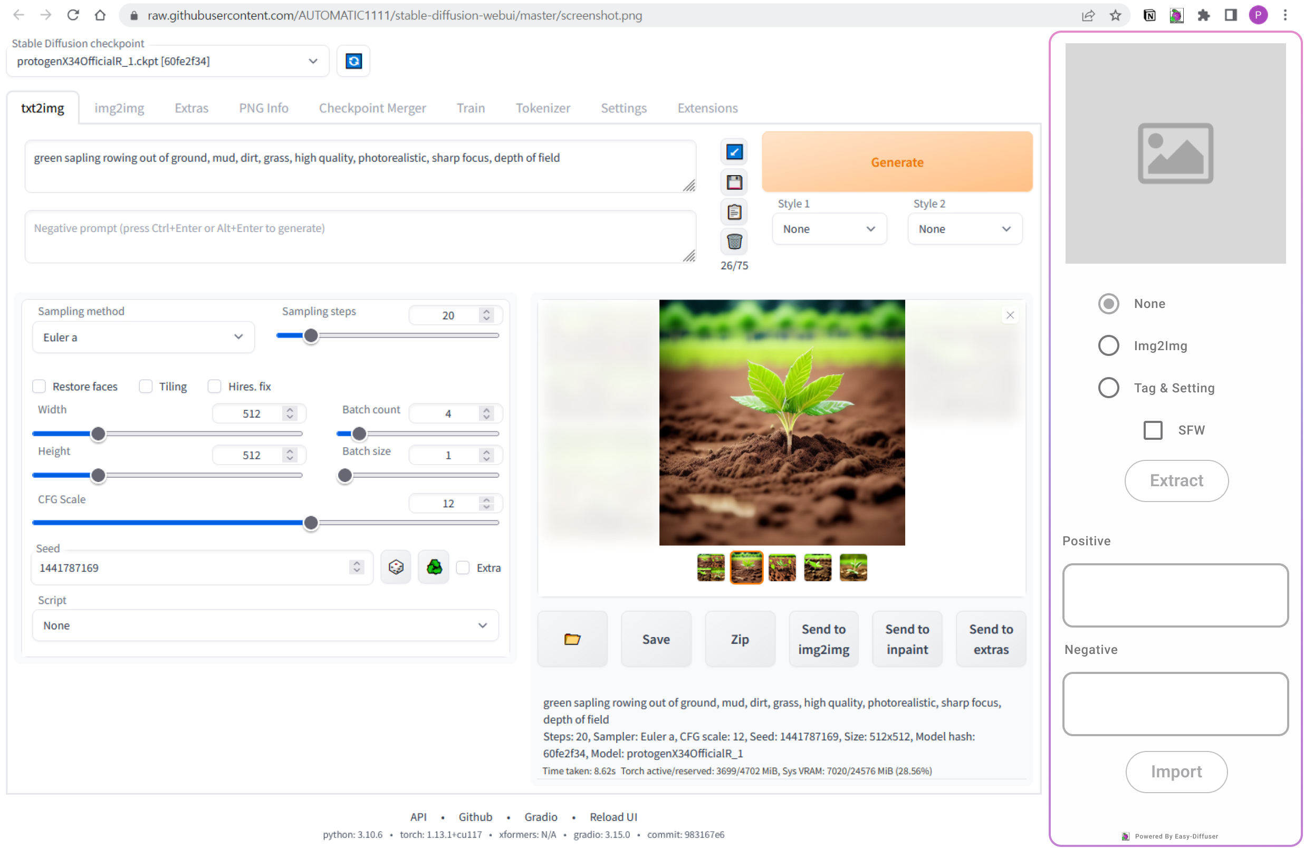
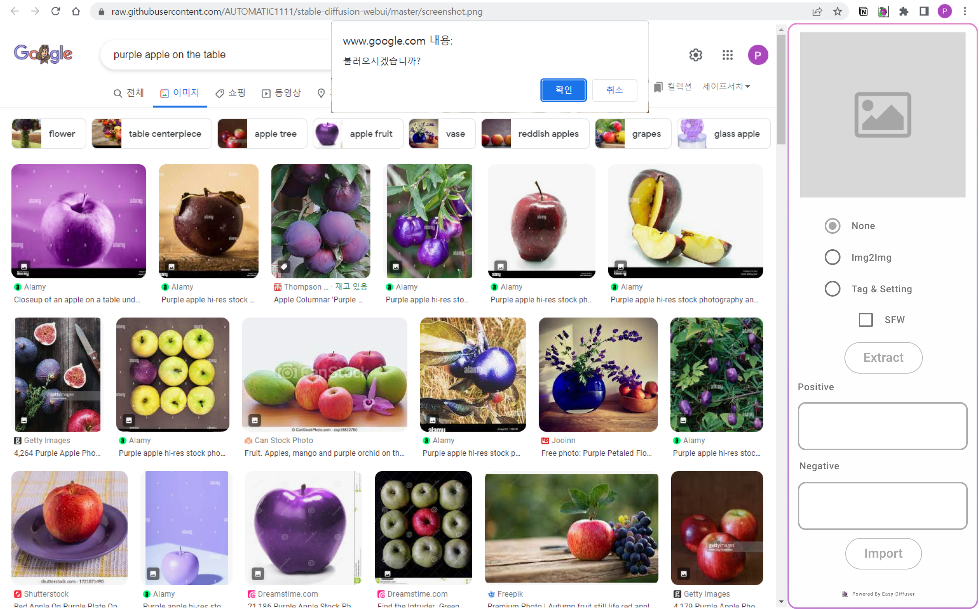
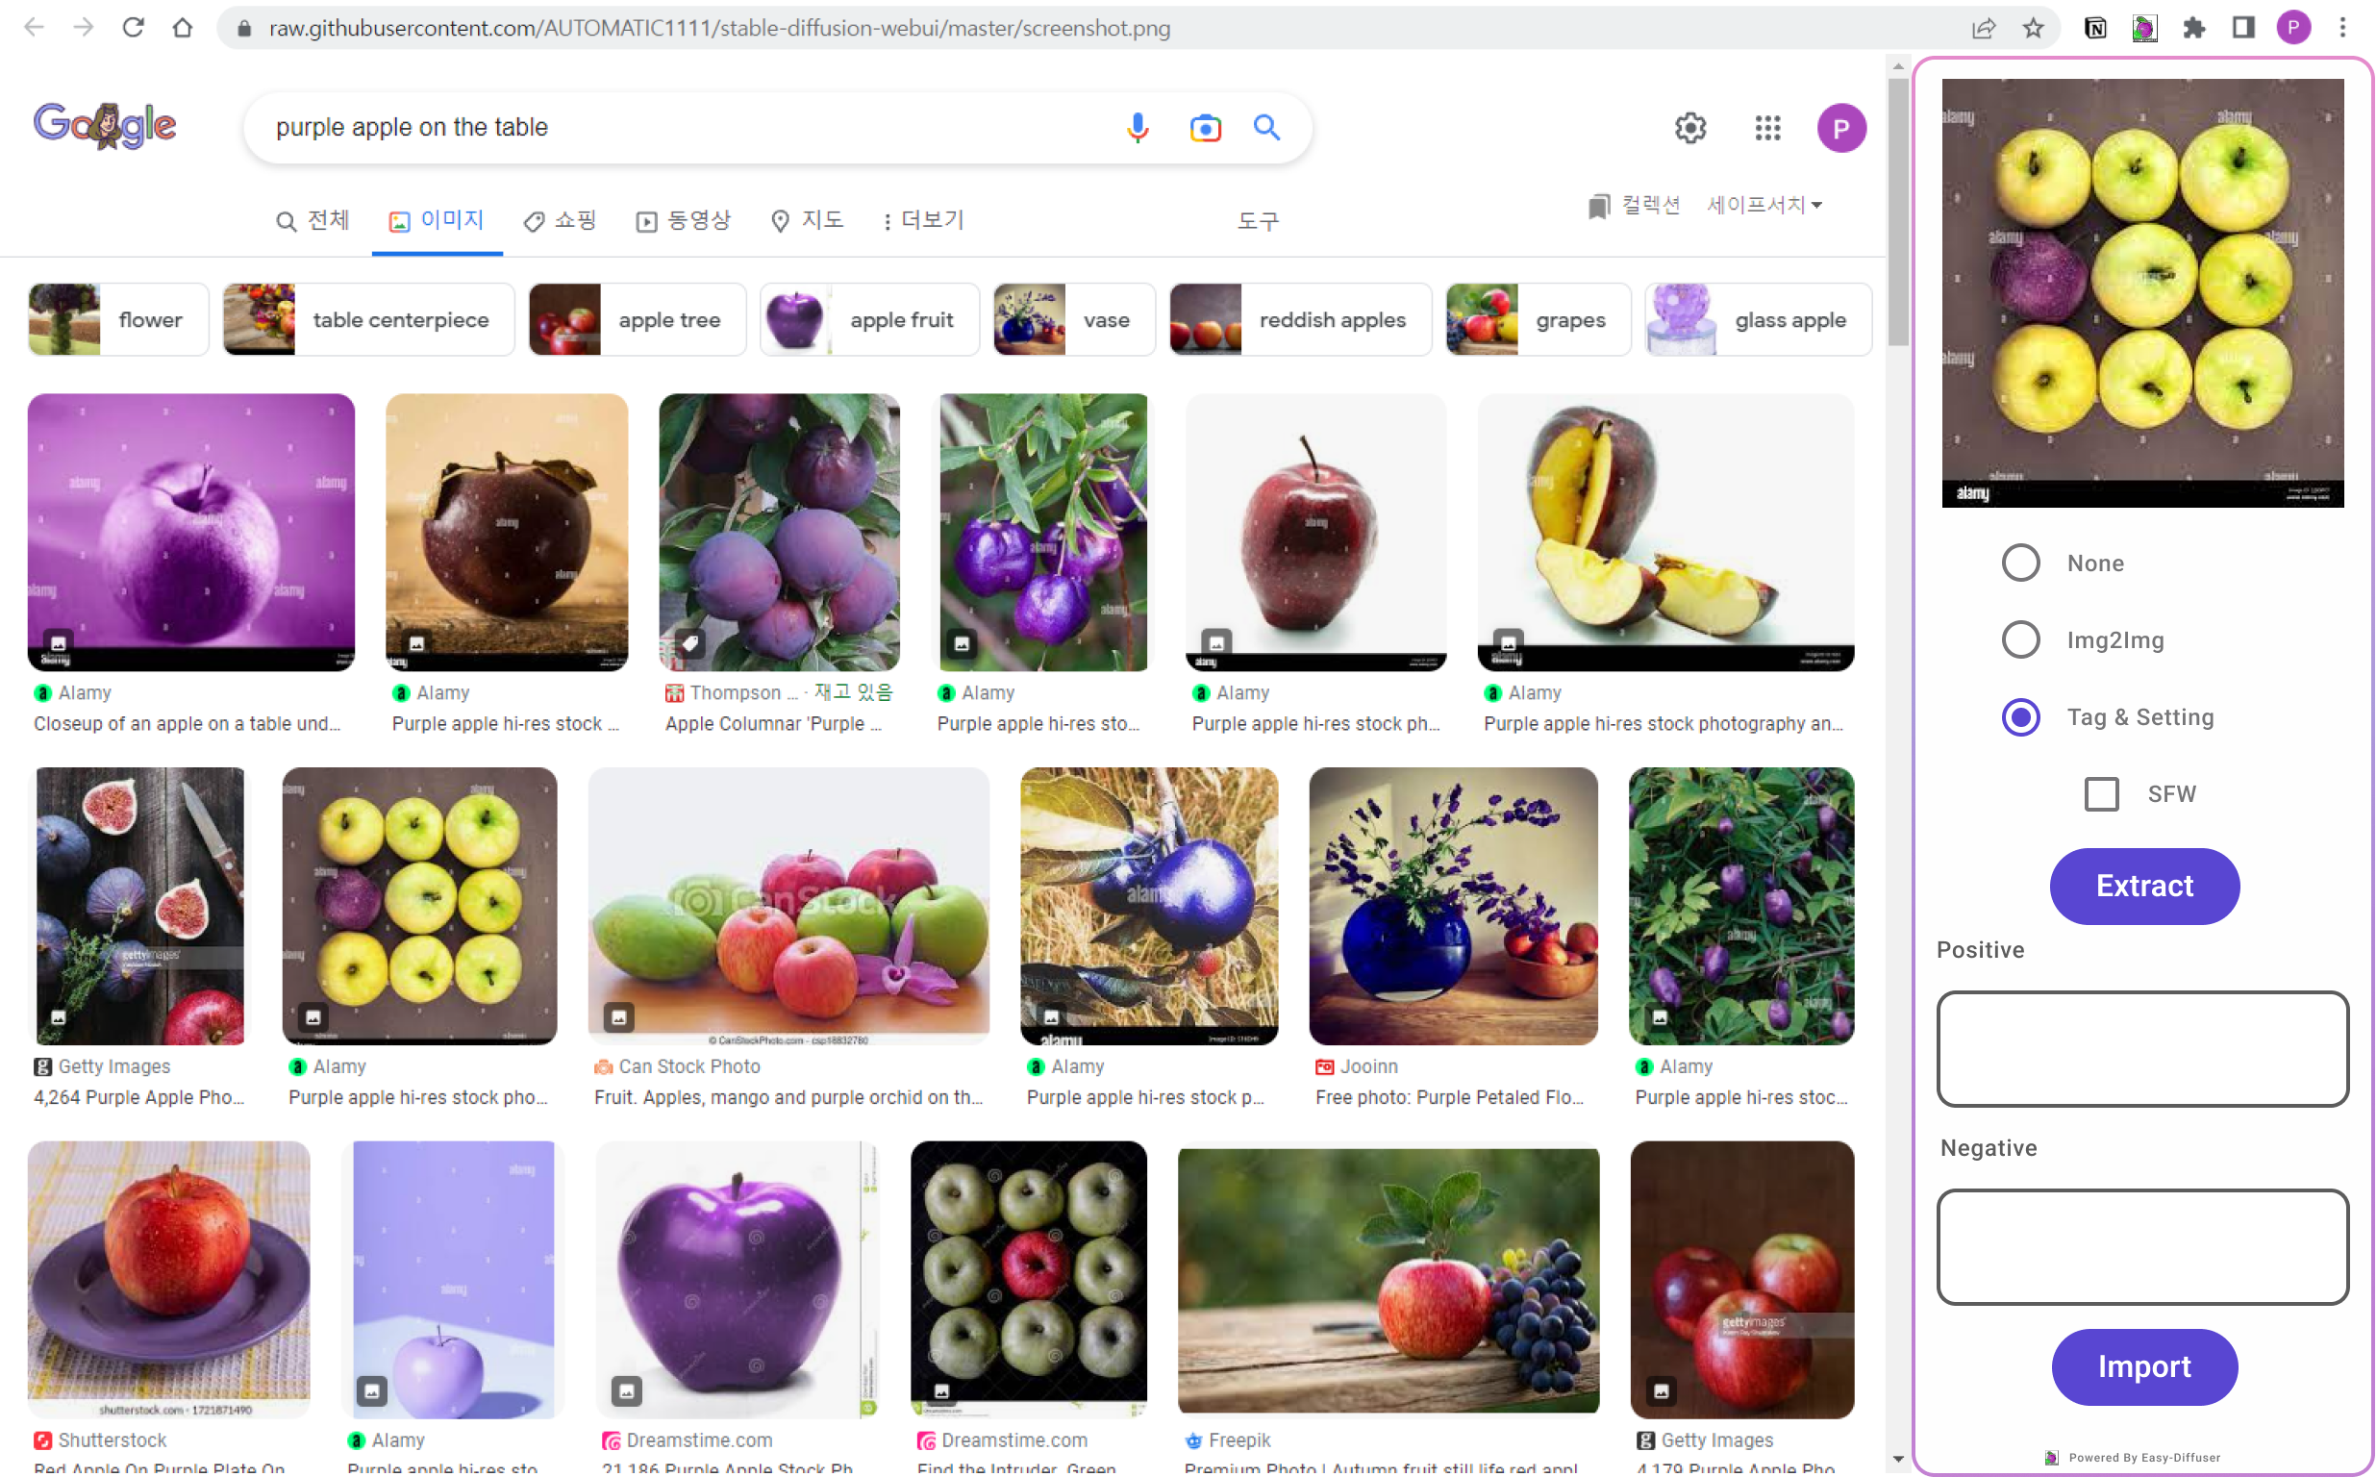

Slide 4
Before running Easy-Diffuser

Slide 6
Run by clicking the button on extension region

Slide 8
Extension running
on the right side

Slide 10
Menu to import selected image

Slide 11
Choose import or not

Slide 13
Image imported

Slide 15
Select Tag & Setting

Slide 17
Click Extract button

Slide 18


Slide 19
Show Clickable tags

